Slide 1
Generic Object Recognition
Slides adapted from Kristen Grauman and Lana Lazebnik

Slide 2
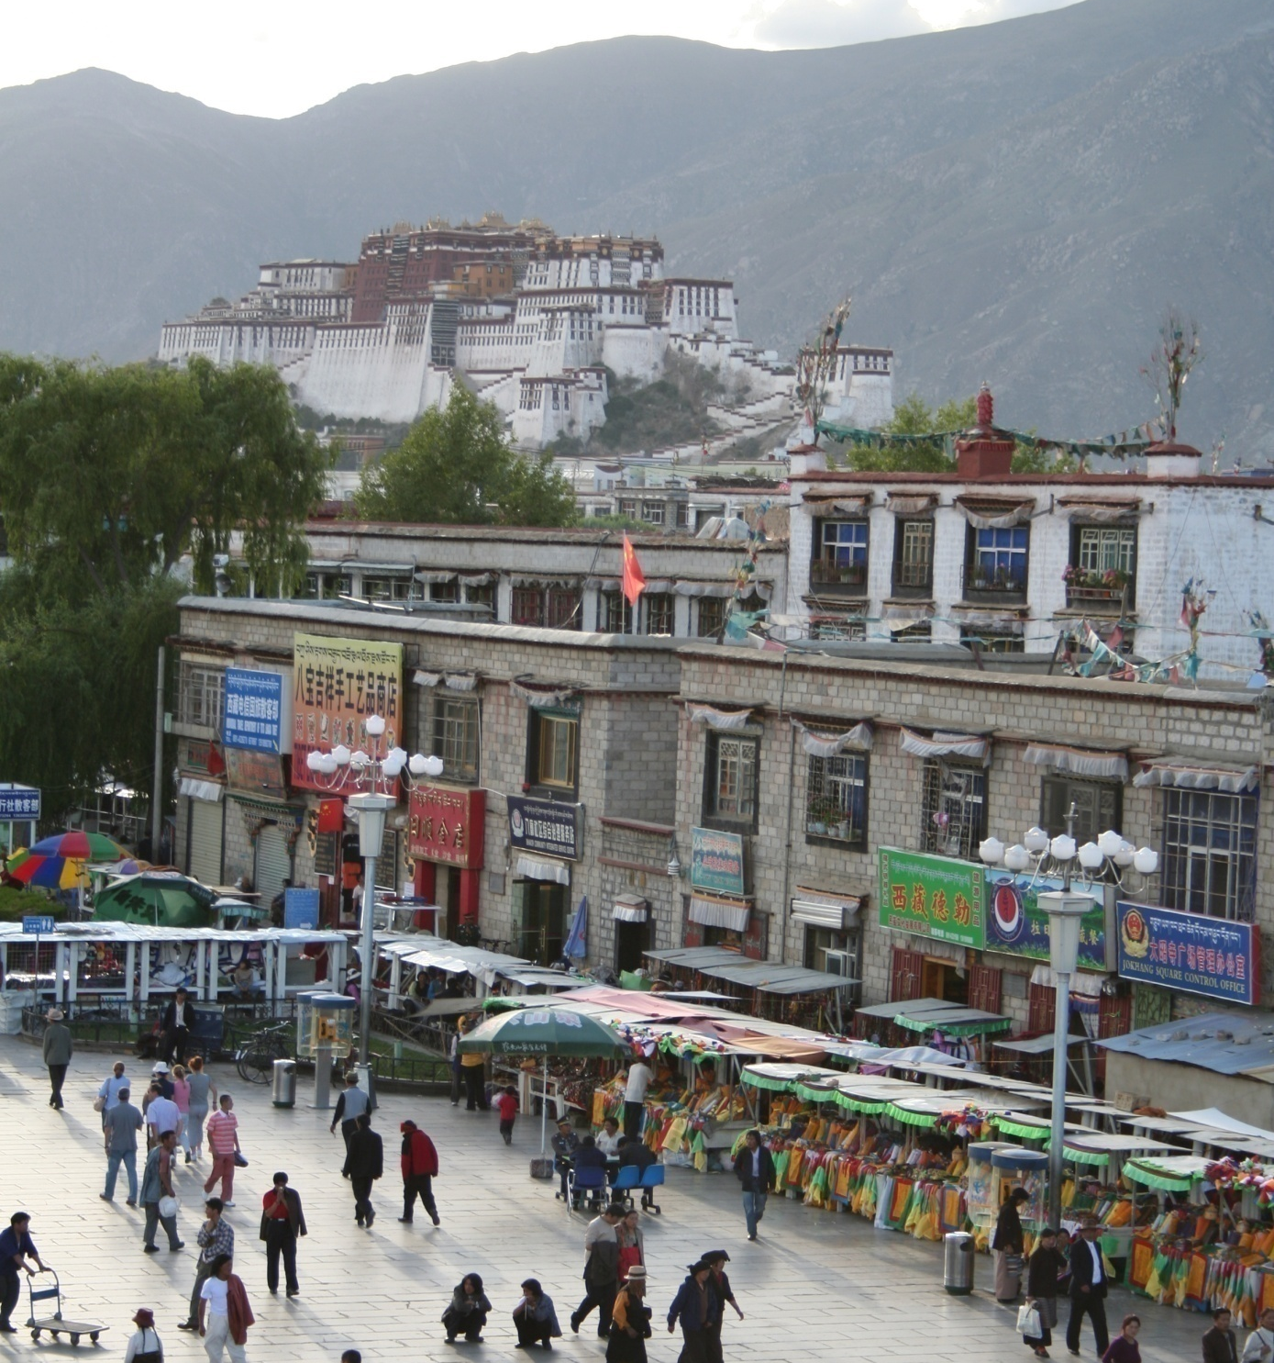
What does recognition involve?
Source: Fei-Fei Li, Rob Fergus, Antonio Torralba.

Slide 3
Verification: is that a lamp?
Source: Fei-Fei Li, Rob Fergus, Antonio Torralba.

Slide 4
Detection: are there people?
Source: Fei-Fei Li, Rob Fergus, Antonio Torralba.

Slide 5
Identification: is that Potala Palace?
Source: Fei-Fei Li, Rob Fergus, Antonio Torralba.

Slide 6
Object categorization
mountain
tree
building
banner
street lamp
vendor
people
Source: Fei-Fei Li, Rob Fergus, Antonio Torralba.

Slide 7
Scene and context categorization
outdoor
city
…
Source: Fei-Fei Li, Rob Fergus, Antonio Torralba.

Slide 8
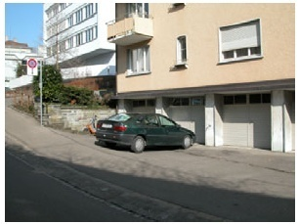
Instance-level recognition problem
John’s car

Slide 9
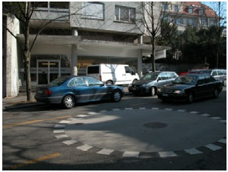
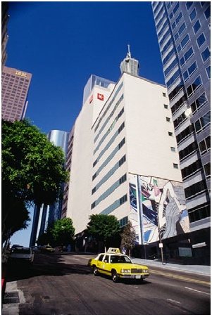
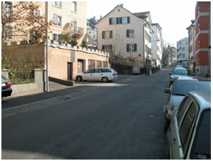
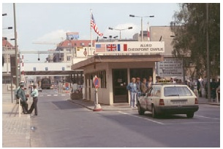
Generic categorization problem

Slide 10
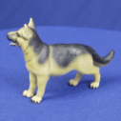
Object Categorization
“Fido”
German shepherd
dog
animal
living being
K. Grauman, B. Leibe
Task Description
“Given a small number of training images of a category, recognize a-priori unknown instances of that category and assign the correct category label.”
Which categories are feasible visually?

Slide 11
Visual Object Categories
Basic Level Categories in human categorization [Rosch 76, Lakoff 87]
The highest level at which category members have similar perceived shape
The highest level at which a single mental image reflects the entire category
The level at which human subjects are usually fastest at identifying category members
The first level named and understood by children
The highest level at which a person uses similar motor actions for interaction with category members
K. Grauman, B. Leibe

Slide 12
Visual Object Categories
…
animal
Abstract levels
…
…
quadruped
…
Basic level
dog
cat
cow
German shepherd
Doberman
Individual level
…
“Fido”
…
K. Grauman, B. Leibe
Basic-level categories in humans seem to be defined predominantly visually.
There is evidence that humans (usually) start with basic-level categorization before doing identification.
⇒ Basic-level categorization is easier and faster for humans than object identification!
How does this transfer to automatic
classification algorithms?

Slide 13
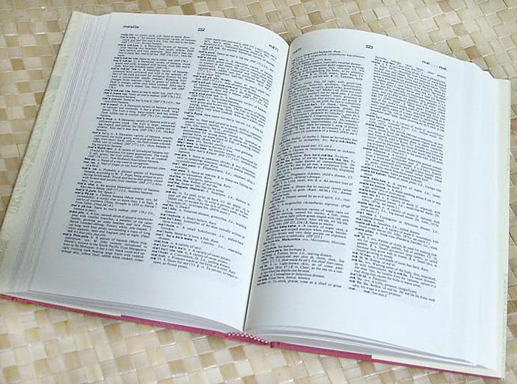

How many object categories are there?
~10,000 to 30,000
Biederman 1987
Source: Fei-Fei Li, Rob Fergus, Antonio Torralba.
Notes:
13

Slide 14
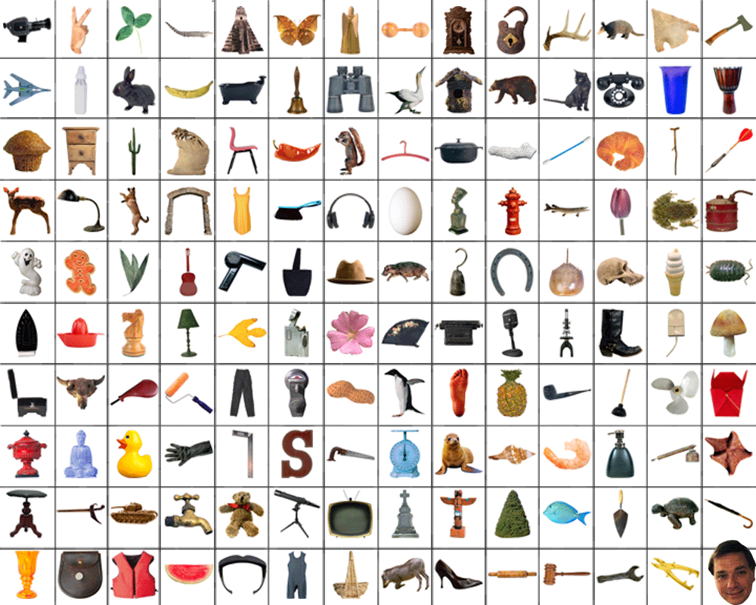
~10,000 to 30,000
Notes:
14

Slide 15
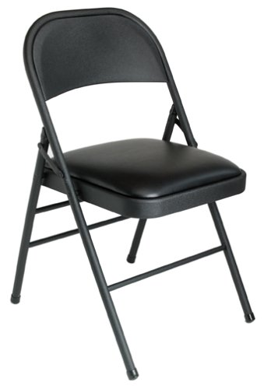
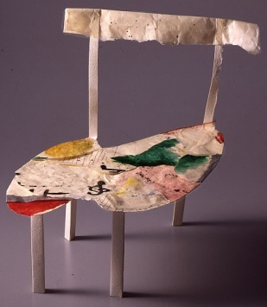
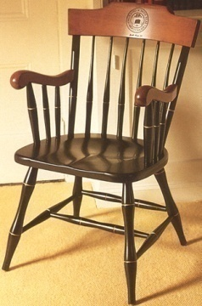
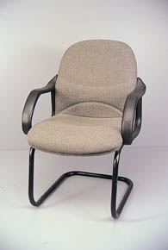
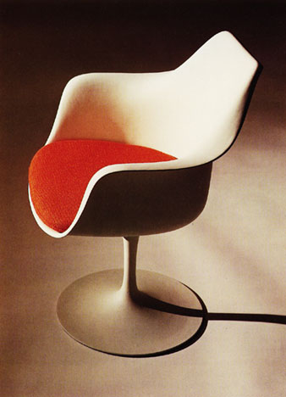
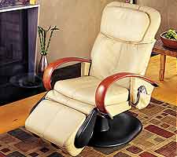
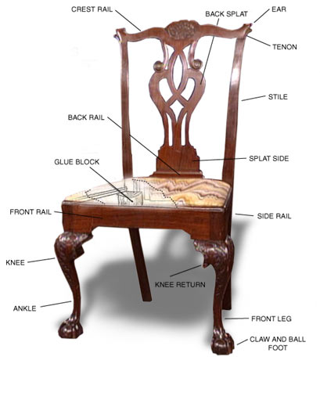
Other Types of Categories
K. Grauman, B. Leibe
Functional Categories
e.g. chairs = “something you can sit on”

Slide 16

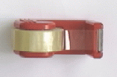
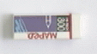

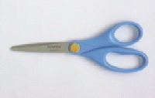
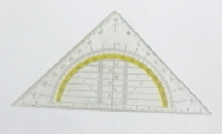
Other Types of Categories
K. Grauman, B. Leibe
Ad-hoc categories
e.g. “something you can find in an office environment”

Slide 17
Why recognition?
Recognition a fundamental part of perception
e.g., robots, autonomous agents
Organize and give access to visual content
Connect to information
Detect trends and themes
Notes:
17

Slide 18
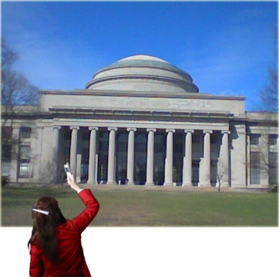
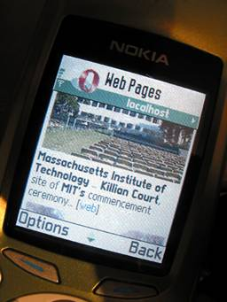
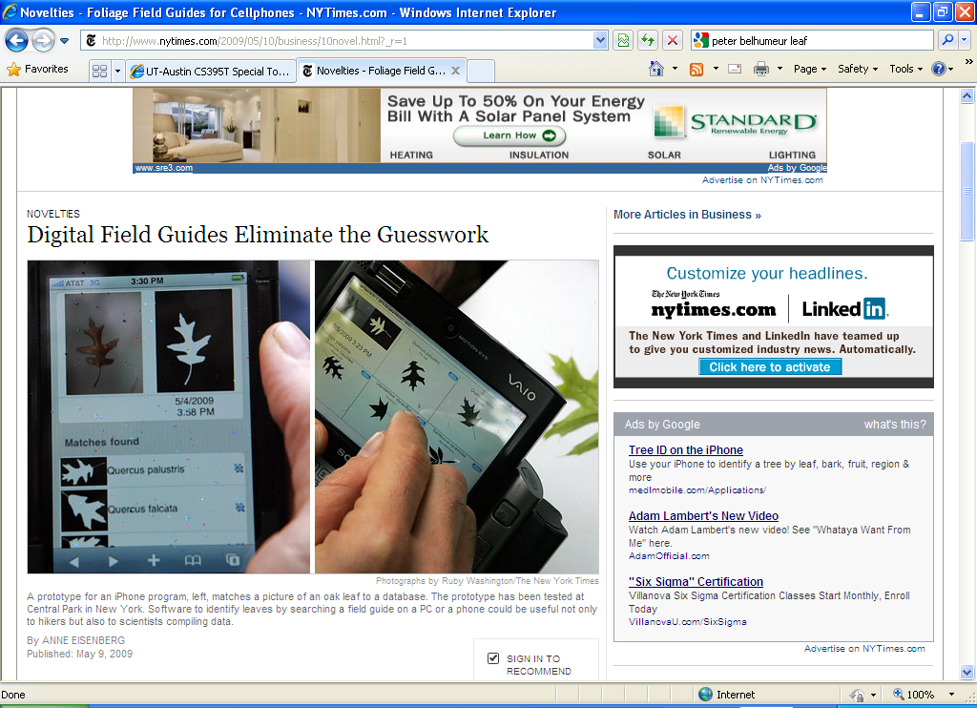


Posing visual queries
Yeh et al., MIT
Belhumeur et al.
Kooaba, Bay & Quack et al.

Slide 19
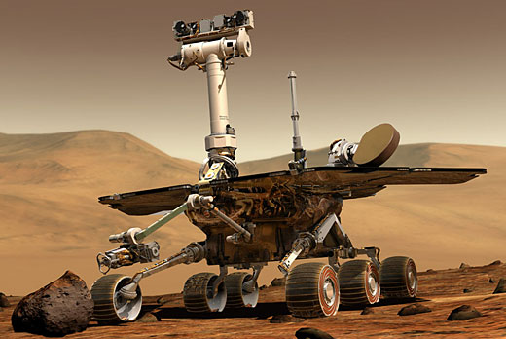
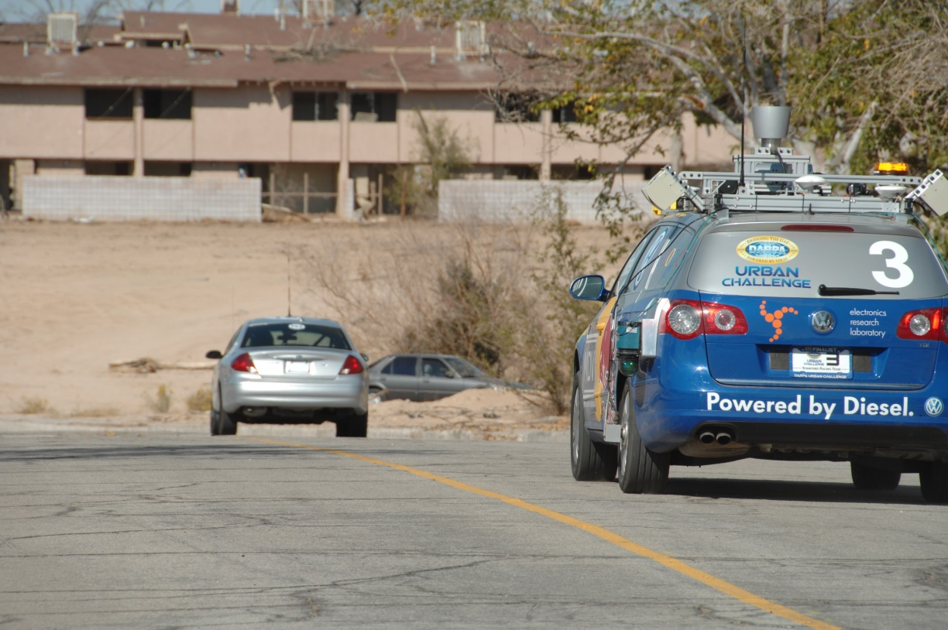
Autonomous agents able to detect objects
http://www.darpa.mil/grandchallenge/gallery.asp

Slide 20

Finding visually similar objects
Notes:
20

Slide 21
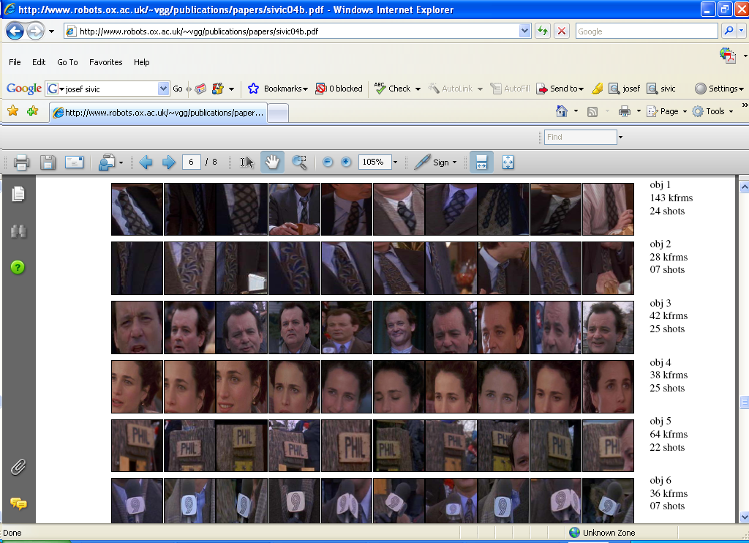
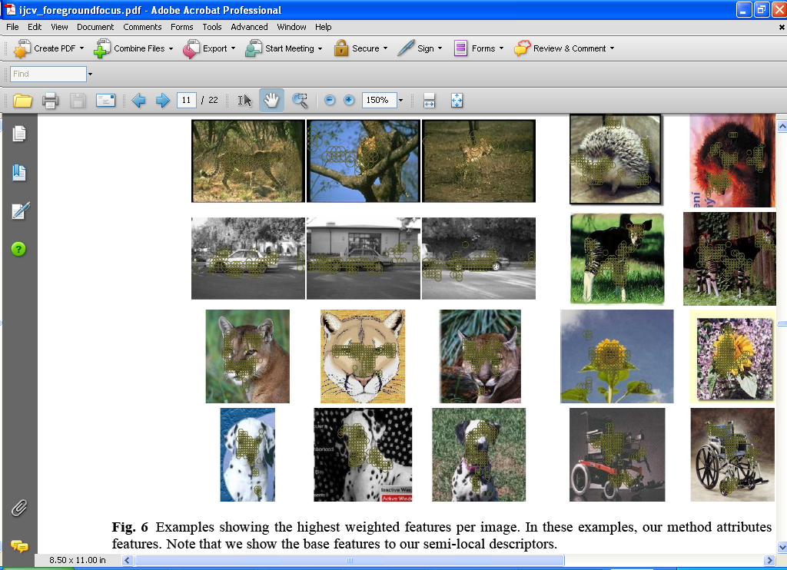
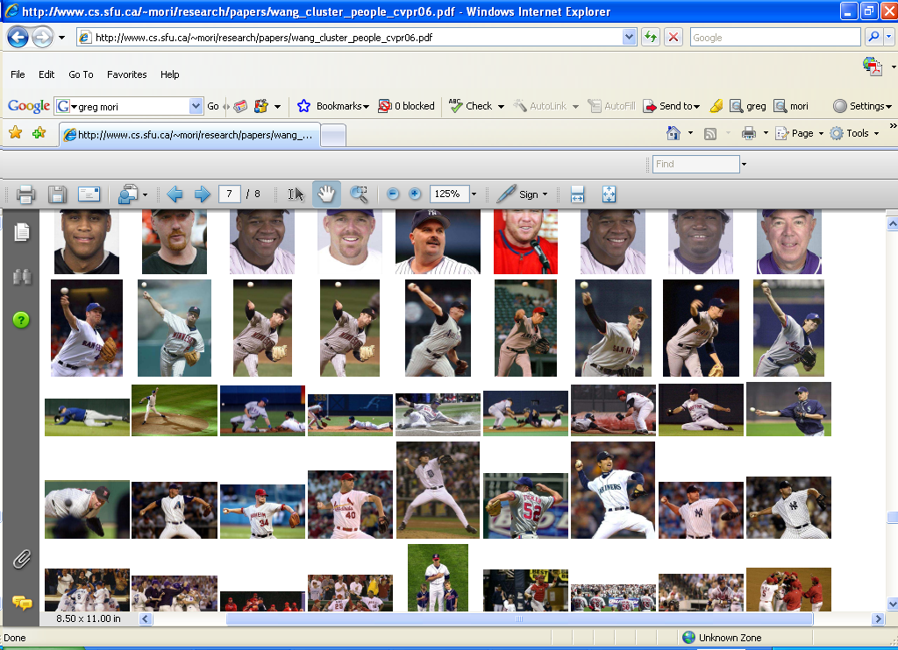
Discovering visual patterns
Objects
Sivic & Zisserman
Lee & Grauman
Categories
Actions
Wang et al.

Slide 22
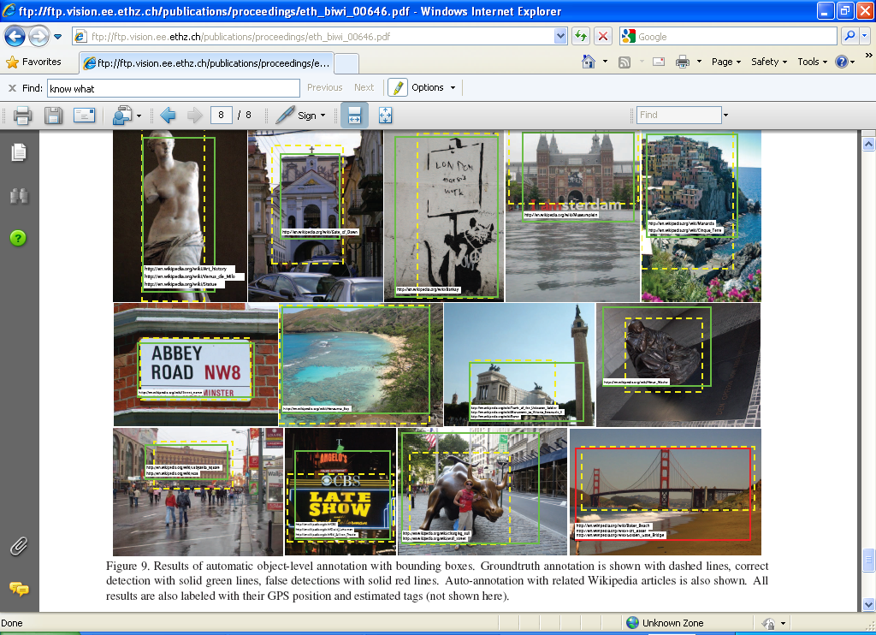
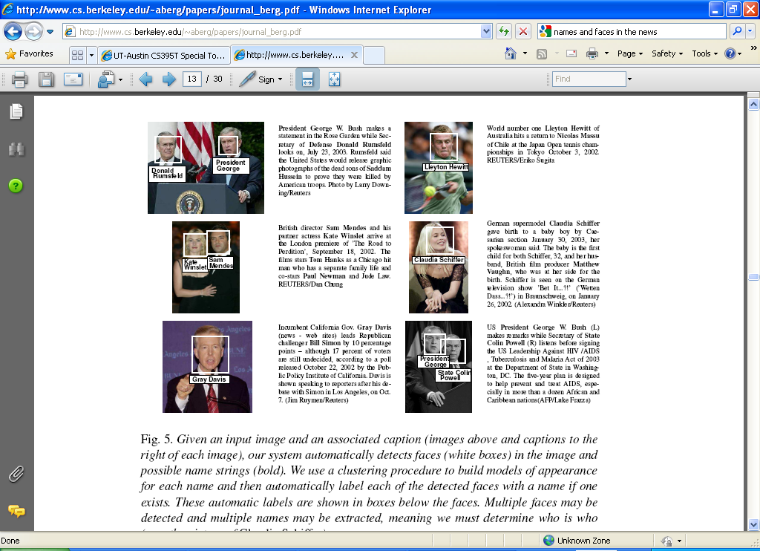
Auto-annotation
Gammeter et al.
T. Berg et al.

Slide 23
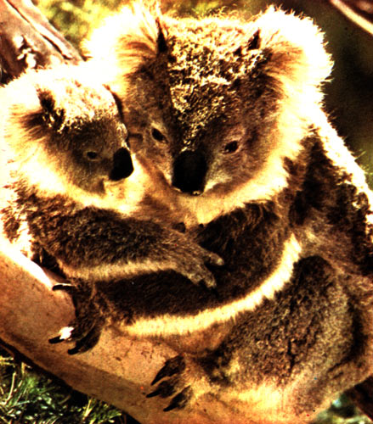
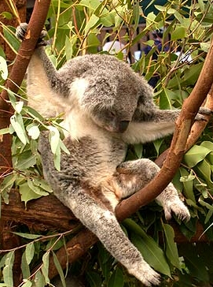
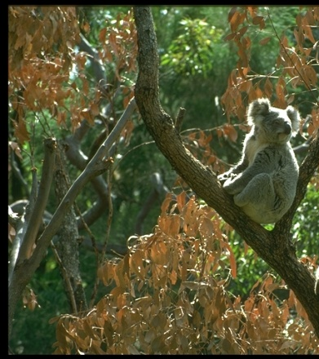
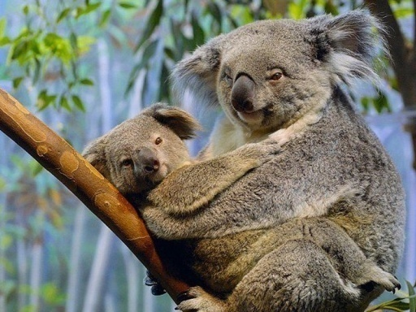
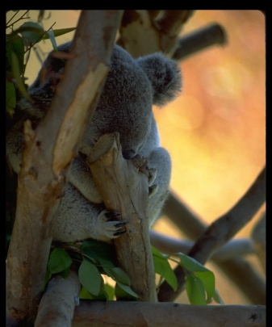
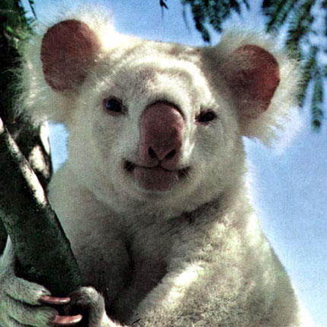
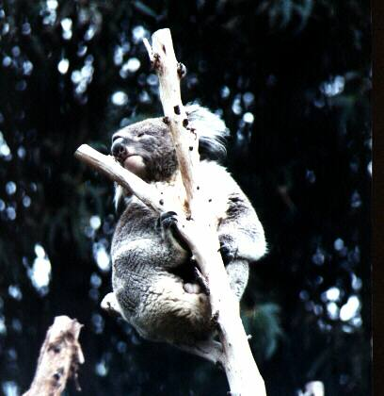
Challenges: robustness
Illumination
Object pose
Clutter
Occlusions
Intra-class appearance
Viewpoint

Slide 24
Challenges: robustness
Realistic scenes are crowded, cluttered, have overlapping objects.

Slide 25


Challenges: importance of context
slide credit: Fei-Fei, Fergus & Torralba

Slide 26
Challenges: complexity
Thousands to millions of pixels in an image
3,000-30,000 human recognizable object categories
30+ degrees of freedom in the pose of articulated objects (humans)
Billions of images indexed by Google Image Search
18 billion+ prints produced from digital camera images in 2004
295.5 million camera phones sold in 2005
About half of the cerebral cortex in primates is devoted to processing visual information [Felleman and van Essen 1991]
Notes:
26

Slide 27
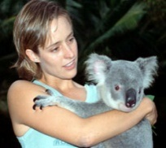
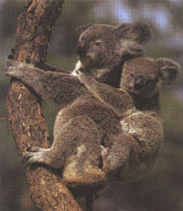










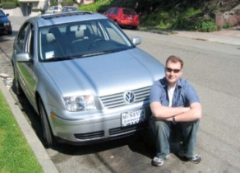



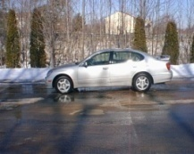



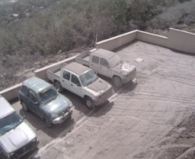

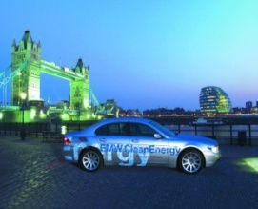
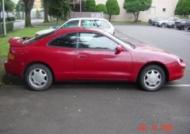


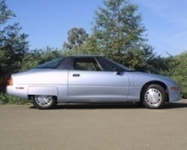

Challenges: learning with minimal supervision
Less
More
Unlabeled, multiple objects
Classes labeled, some clutter
Cropped to object, parts and classes labeled

Slide 28
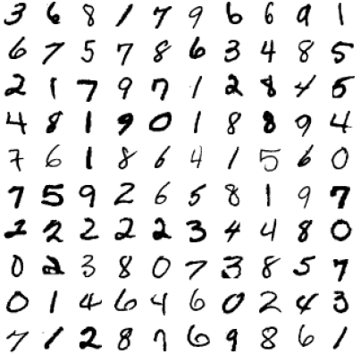
What works most reliably today
Reading license plates, zip codes, checks
Notes:
28

Slide 29
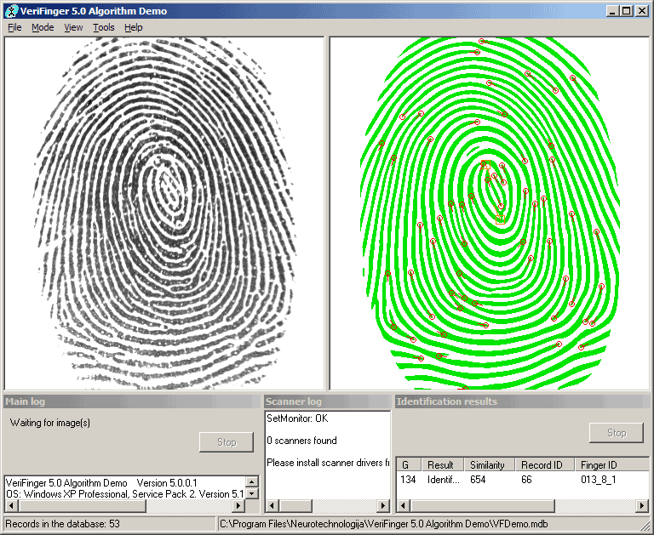
What works most reliably today
Reading license plates, zip codes, checks
Fingerprint recognition
Notes:
29

Slide 30
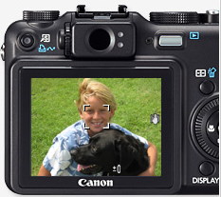
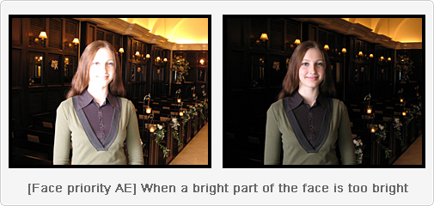
What works most reliably today
Reading license plates, zip codes, checks
Fingerprint recognition
Face detection
Notes:
30

Slide 31
What works most reliably today
Reading license plates, zip codes, checks
Fingerprint recognition
Face detection
Recognition of flat textured objects (CD covers, book covers, etc.)
Notes:
31

Slide 32
Generic category recognition: basic framework
Build/train object model
Choose a representation
Learn or fit parameters of model / classifier
Generate candidates in new image
Score the candidates

Slide 33


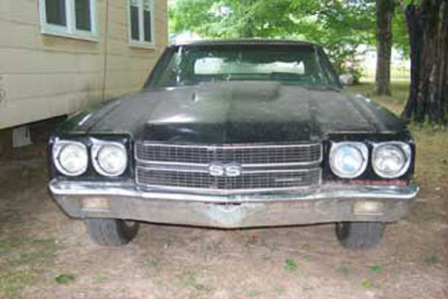
Generic category recognition: representation choice
Window-based
Part-based

Slide 34
Summary
Instance-level matching (last class)
Find features and make sure enough match correctly
Category-level matching (today)
Starts with features, but direct matching is not enough
How do we know which features (or what type) are useful?
Let a computer do it!
Next class: Machine Learning for Computer Vision

